Slide 1
Petty Kadai Presentation

Slide 2
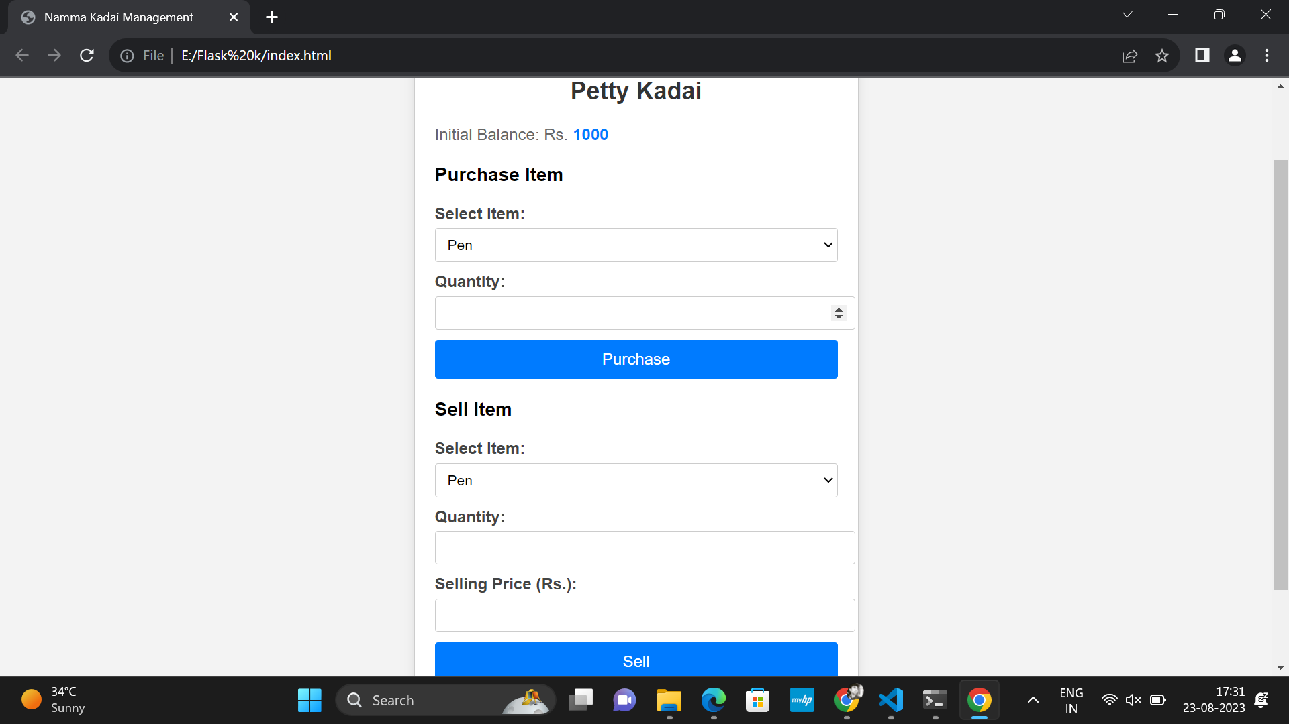
Home Page

Slide 3
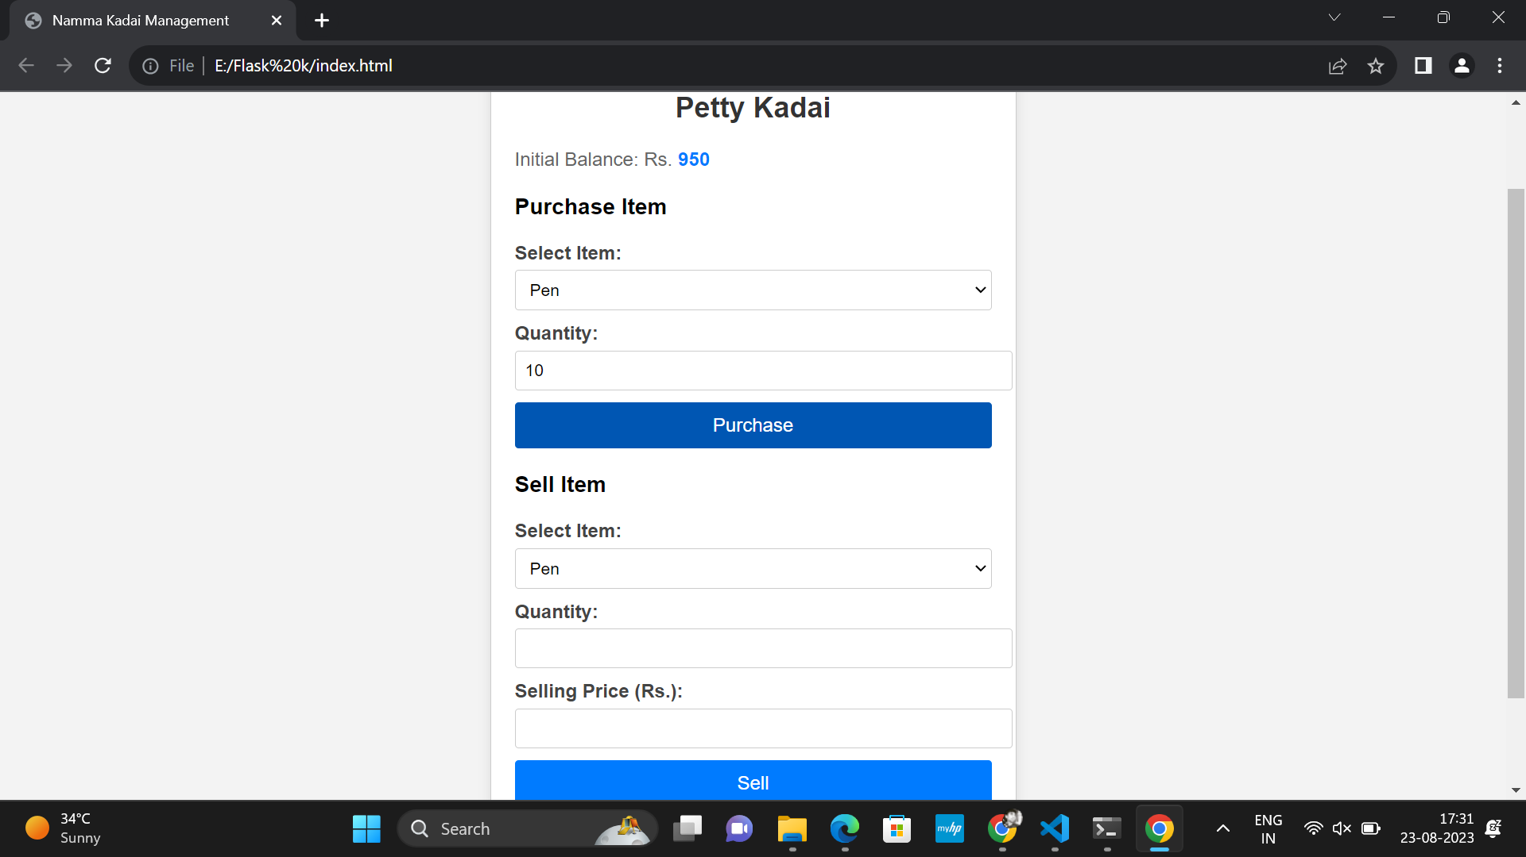
Purchase Page

Slide 4

Sells Page

